Slide 1
Safeguards to company with APES 110 - SMSF Auditor Independence Requirements
Manoj Abichandani
ASIC Approved SMSF Auditor
SMSF Specialist (UNSW)

Slide 2
House Keeping - Audio
If Computer sound is not audio able
Phone the number on your panel
Enter Access Code

Slide 3
House Keeping – Hand Out
Copy of this Presentation can be downloaded
From the Panel

Slide 4
House Keeping – Questions on this Presentation
If you have any Questions on this Presentation
Type in your questions in the panel
Speaker will answer all your questions
after the presentation

Slide 5
Disclaimer of Legal & Financial Advice – Educational Purpose Only
Statement
This paper represents the opinion of the author (s) and not necessarily those of Deed Dot Com Dot Au Pty Ltd. The contents are for general information only. They are not intended as professional advice - for that you should consult a Accountant or other suitably qualified professional. Deed Dot Com dot Au Pty Ltd expressly disclaims all liability for any loss or damage arising from reliance upon any information in this presentation.
Disclaimer
The information contained in this presentation is based on the understanding of the author has of the relevant Australian laws as at 16th March 2021. As these laws are subject to change you should refer to ATO’s website or talk to a professional adviser for the most up-to-date information. The information is for adviser use only and is not a substitute for investors seeking advice. While all care has been taken in the preparation of this document (using sources believed to be reliable and accurate), no person, including Deed Dot Com Dot Au Pty Ltd, accepts responsibility for any loss suffered by any person arising from reliance on this information. This update is not financial product advice and does not take into account any individual’s objectives, financial situation or needs. Any examples are for illustrative purposes only and actual risks and benefits will vary depending on each investor’s individual circumstances. You should form your own opinion and take your own legal, taxation and financial advice on the application of the information to your business and your clients.

Slide 6
AGENDA
Auditing Standards & Legislation behind Auditor independence
How to test your own “Independence”
How to apply for Safeguards to remain independent

Slide 7
Auditing Standard on Independence

Slide 8
AUSB - ASA 220 – Independence – Para 11 Quality Control for an Audit of a Financial Report and Other Historical Financial Information
The engagement partner shall form a conclusion on compliance with independence requirements that apply to the audit engagement. In doing so, the engagement partner shall
Obtain relevant information from the firm and, where applicable, network firms, to identify and evaluate threats to independence;
Evaluate information on identified breaches, if any, of the firm’s independence policies and procedures to determine whether they create a threat to independence for the audit engagement;
Evaluate whether the identified threats are at an acceptable level; and
Take appropriate action to address the threats that are not at an acceptable level by eliminating the circumstances that create the threats, applying safeguards to reduce threats to an acceptable level, or withdrawing from the audit engagement, where withdrawal is possible under applicable law or regulation. The engagement partner shall promptly report to the firm any inability to resolve the matter for appropriate action.

Slide 9
Apply Safeguards – withdrawing from the
audit engagement
Their own or an immediate family member’s SMSF
(paras R510.4, R521.5 and R523.3);
Where a partner within their own firm is a member/trustee of that SMSF
(para R523.3)
Where they have a business relationship with a member/trustee of the SMSF
(para 520.3 A1 to 520.4 A1)
Where a relative or a related party of the auditor is a member/ trustee of that SMSF or where the auditor has a close personal relationship
(paras 521.3 A1 to 521.7 A3)
Where an audit team member on the audit of a SMSF has a close family member (parent, child or sibling who is not an immediate family member) that is a member and trustee of that SMSF
a reasonable and informed third party would likely conclude that a self-interest threat to independence is not an acceptable level and must be addressed (paras 510.10 A5 to 510.10 A8

Slide 10
APES 110
Code of Professional Ethics For Accountants
By Professional Bodies

Slide 11
Purpose of the Code
The Code of Ethics for Professional Accountants (including Independence Standards) (“the Code”) sets out fundamental principles of ethics for Members, reflecting the profession’s recognition of its public interest responsibility. These principles establish the standard of behaviour expected of a Member. The fundamental principles are: integrity, objectivity, professional competence and due care, confidentiality, and professional behaviour.
The Code provides a conceptual framework that Members are to apply in order to identify, evaluate and address threats to compliance with the fundamental principles. The Code sets out requirements and application material on various topics to help Members apply the conceptual framework to those topics.
In the case of Audits, Reviews and other assurance engagements, the Code sets out Independence Standards, established by the application of the conceptual framework to threats to Independence in relation to these engagements.

Slide 12
APES 110 – Section 120
When assessing independence, the auditor:
identifies any threats to compliance with the fundamental principles (and independence);
evaluates whether the identified threats are at an acceptable level; and
addresses any identified threats that are not at an acceptable level by
eliminating the circumstances, including interests or relationships, that are creating the threats;
applying safeguards where available and capable of being applied, to reduce the threats to an acceptable level; or
declining or ending the engagement.

Slide 13
APES 110 – Section 120
Identifying threats to the fundamental principles of independence requires an understanding by the auditor of the facts and circumstances (including any professional activities, interests and relationships) that might compromise compliance with the fundamental principles.
Threats will fall into one or more of the following categories:
Self-interest threat;
Self-review threat;
Advocacy threat;
Familiarity threat; and
Intimidation threat.

Slide 14
Threats to Independence
Self Review
Threats may exist that the auditor may not appropriately evaluate the results of previous judgements made, or advice provided, to clients of the firm when the auditor was a partner of the firm.
Self Interest
Will inappropriately influence their judgement or behaviour. For example, the auditor may be reluctant to issue an adverse finding for fear of losing this referral source
Intimidation
Will be deterred from acting objectively because of actual or perceived pressures from the referral source
Familiarity
Auditor may be too accepting of the work of the firm they previously worked at
Where minimal time has passed since the auditor was a partner of the firm

Slide 15
Legislation behind SMSF Auditor independence

Slide 16
SIS Act - Section 128F(d) SIS Regulations – Reg 9A.06
SISA 128F (d) comply with the auditor independence requirements prescribed by the regulations
SISR 9A.06 Auditor independence requirements
For paragraph 128F(d) of the Act, the auditor independence requirements produced by the Accounting Professional and Ethical Standards Board Limited and set out in the APES 110 Code of Ethics for Professional Accountants (including Independence Standards) are prescribed for all approved SMSF auditors.

Slide 17
NEW APES 110 RULES
Audit Firm shall not assume a management responsibility
for an audit client (Para R600.7)

Slide 18
Firms or network firms must not assume financial preparation responsibility for an audit client
Where an accountant assumes management responsibility for the preparation of financial statements for a SMSF then the service would not be routine or mechanical
Self-review threat which arises, were that same firm to undertake an audit of those financial statements, would be so great that no safeguard could reduce the threat to an acceptable level.
Firm or Networking firms
must resign as an Auditor of SMSF

Slide 19
Staff member within an Audit Firm prepares financial statements
Self Review
Auditor will not evaluate the results of judgements made by that staff member
No Safeguards
Firm would not be able to put appropriate safeguards in place to reduce the threat to an acceptable level, as all of their staff are essentially reporting to them
Action
The auditor must decline the audits for their SMSF clients

Slide 20
Trustee prepared Trial Balance Accounting firm acts as Tax Agent Only
Action
If the accounting firm prepares tax calculations of current and deferred tax liabilities (or assets) that are material to the financial statements, the auditor may not be able to eliminate the circumstances creating the threats to independence.
Self Review
Will not generally create a self-review threat.
Tax calculations could create a self-review threat

Slide 21
Where the auditor was previously a Partner or employee of the firm
Self Review
Threats may exist that the auditor may not appropriately evaluate the results of previous judgements made, or advice provided, to clients of the firm when the auditor was a partner of the firm.
Familiarity
Auditor may be too accepting of the work of the firm they previously worked at
Where minimal time has passed since the auditor was a partner of the firm
Action
Where minimal time has passed since the auditor was at the firm, a reasonable and informed third party would likely assess that threats to independence would not be at an acceptable level
Time
ATO = At least +2 years have passed

Slide 22
Test your own
“Independence”

Slide 23
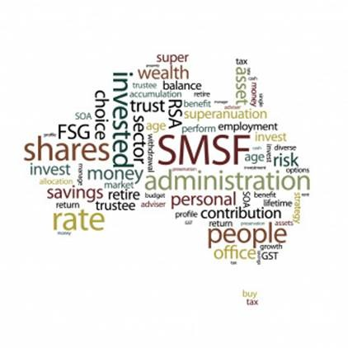
Reciprocal Arrangements / Auditor Pool
Firm A :SMSF Admin & Audit
Firm B :SMSF Admin & Audit

Slide 24
Reciprocal Arrangements / Auditor Pool
Self Interest
Member A may be less likely to issue adverse findings about Member B’s SMSF in fear that Member B may subsequently issue adverse findings on A’s SMSF
Familiarity
Threat that each auditor will be sympathetic to the other’s interests or too accepting of each other’s work
Intimidation
one auditor may exercise undue influence on the other auditor not to issue an adverse finding.

Slide 25
Relationships between auditors & Referral sources (SMSF Administrators)
Auditing multiple SMSF clients of an administration firm
Auditor conducting SMSF audits for an accounting firm where the principal is related to the auditor
Reciprocal auditing arrangements relating to auditors who audit each other’s fund and auditors auditing each other’s SMSF clients
Concentration of referral sources – not more than 20% from one source

Slide 26
Significant fee from one referral Source
Self Interest
Will inappropriately influence their judgement or behaviour. For example, the auditor may be reluctant to issue an adverse finding for fear of losing this referral source
Intimidation
Will be deterred from acting objectively because of actual or perceived pressures from the referral source
Action
Where a large proportion of an auditor’s fees comes from one referral source -20%, the auditor must evaluate the significance of the threat and apply safeguards when necessary to eliminate the threat or reduce it to an acceptable level (para AUST R410.3.1)
Solution
Get more clients / Appoint a reviewer
No Solution
Decline if safeguard is not possible

Slide 27
More than 20% coming from one source
SMSF Audits
400 Funds
SMSF Administrators
SMSF Auditor
Currently Auditing
200 Funds
Intimidation
Will be deterred from acting objectively because of actual or perceived pressures from the referral source

Slide 28
How much fee is OK from
one referral source
Action
Where a large proportion of an auditor’s fees comes from one referral source, the auditor must evaluate the significance of the threat and apply safeguards when necessary to eliminate the threat or reduce it to an acceptable level
(para AUST R410.3.1)

Slide 29
Fee Dependency Risk
15%
Potential threats
to audit clients that are public
interest entities (PIEs)
(R410.4 of APES 110),
20%
May expose the firm to a significant business risk if the client is lost
30%
International Ethics Standards Board
for Accountants (IESBA) non-PIEs
IESB Fees Exposure Draft
(APESB) recommended removing the proposed threshold for non-PIE
audit clients and replacing it with the same threshold as PIEs (15%).

Slide 30
Safeguard – when accepting a new business
Audit Firm auditing 2000 can absorb another
400 Funds = Total $2400
New Funds 400/2400 = 16.66%
SMSF Auditor 1
SMSF Auditor
Currently Auditing
2000 Funds – 10 Firms
SMSF Auditor 2
New Business
SMSF Audits - 400 Funds
SMSF Audit Firm
SMSF Administrator

Slide 31
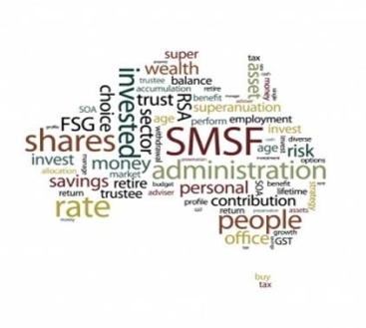
Does not make the mark 33%
SMSF Audits 33%
SMSF Admin Firm
SMSF Audits 33%
SMSF Admin Firm
SMSF Auditor
SMSF Audits 33%
SMSF Admin Firm

Slide 32
Introducing SMSF Auditors Hub
WWW.smsfauditorshub.com.au

Slide 33
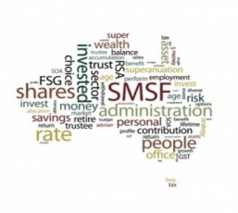
Future of SMSF Audits One Mega Audit Firm
Admin Co. 1
Admin Co. 2
Admin Co. 3
Admin Co. 4
Admin Co. 5
Mega Audit Firm
Auditor 1
Auditor 2
Auditor 3
Auditor 4
Auditor 5

Slide 34
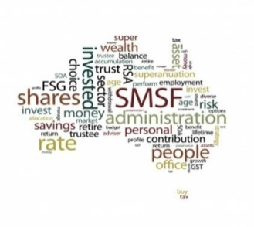
SMSF Auditors Hub – Over 40 Auditors
SMSF Admin Firm
SMSF Admin Firm
SMSF Admin Firm
SMSF Admin Firm
SMSF Admin Firm
SMSF Auditor
SMSF Auditor
SMSF Auditor
SMSF Auditor
SMSF Auditor

Slide 35
Benefits of using - SMSF Auditors Hub
It does not matter who is the auditor – the fund gets audited – Fast !
There is one price – Its certain what you will pay
Top Quality Audit on an online platform which meets and exceed legislative and proven ATO requirements
10 Days guarantee - Quick
Full team Auditors & Staff members already in place
Online upload of documents – Download of Audit Reports
Clients can also upload documents for Accounting purposes

Slide 36
Why choose SMSF Auditors Hub
8) Experience & Expertise across a wide variety of funds and contemporary best practice
9) Scale to develop efficient systems and processes using our online audit software and pre made templates or audit reports etc.
10) Our audit capacity 10,000 - 20,000 audits a year so are not reliant on a small group of people
11) Strong understanding of the admin platform and strong relationships with the admin system providers
12) Efficient communication platform between all parties so dealing with queries is smoother on both ends
13) Online Platform free for SMSF Administrators

Slide 37
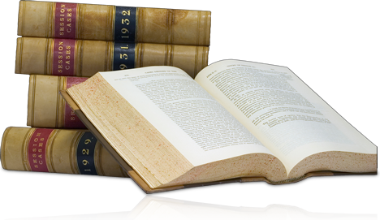
Any Questions ??
Manoj Abichandani
ASIC Approved SMSF Auditor
SMSF Specialist (UNSW)

Slide 38
For further Enquires
please visit our websites:
www.trustdeed.com.au
www.onlinesmsfaudit.com.au
www.justsign.com.au
and chat with our agent.
Alternatively, you - contact us 0296844199 or
Email us at
sales@trustdeed.com.au
sales@onlinesmsfaudit.com.au
sales@justsign.com.au

